Slide 1





Electronic-Sales Command Deck
Aduga Emmanuel
12/09/2025

Slide 2



CONTENTS
01
Opportunity in Focus
02
Data & Method
03
What We Found
04
Security & UX
05
Decisions & Next Steps

Slide 3


01
Opportunity in Focus

Slide 4

From Fragmented Data to Unified Command
The CEO needed a single source of truth for rapid, strategic decisions. This dashboard unifies 15,000+ transactions into a secure, interactive report, eliminating delays caused by fragmented spreadsheets.
Rapid Decisions
Secure Access
Real-time insights for inventory and investment.
Row-level security for Regional Directors.

Slide 5
Quantified Answers to Key Business Questions
Sales Drivers
Promotion ROI
Which channels & product categories generate the majority of revenue?
Which promotions are most effective and worthy of scaling?
Geographic Performance
Accountability & Targets
Which states and zones are over- or under-performing?
Who is responsible for each region, and how do sales compare to targets?

Slide 6
02
Data & Method

Slide 7
The Data Transformation Pipeline
xlsx
1. Raw Data Load
2. Data Cleaning
3. Star Schema
Imported 6 tables (Sales, Product, State, etc.)
Removed dupes, standardized currencies to ₦.
Built a central fact table with related dimensions.
Result: A clean, scalable data model ready for complex analysis and visualization, including a population table for per-capita insights.

Slide 8
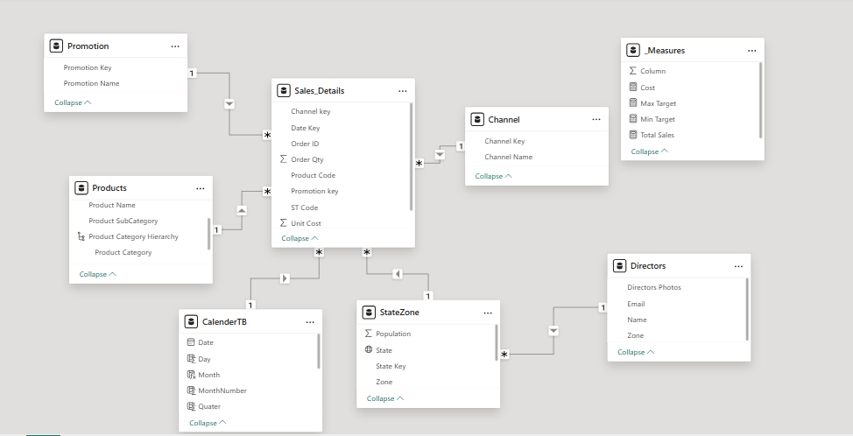
Star Schema

Slide 9




The Engine: Key DAX Measures
Total Sales
Sum Order Quantity
The core measure, calculating gross sales by multiplying unit price and quantity for every transaction.
Provides a count of total items sold, useful for inventory and operations analysis.
Target Comparisons
Time Intelligence
Flexible measures to benchmark performance against predefined minimum and maximum sales goals.
Enables analysis of sales trends over time (Year-over-Year, Quarter-over-Quarter).

Slide 10
03
What We Found

Slide 11
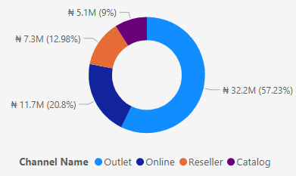
Revenue is Concentrated
A small number of channels, products, and promotions drive the majority of sales, revealing clear strategic priorities.
Channel Sales Breakdown
Outlet Channel
57.2%
Top 3 Product Categories
Camcorders, Projectors, Laptops
Adventist Promo
#1 Performing

Slide 12
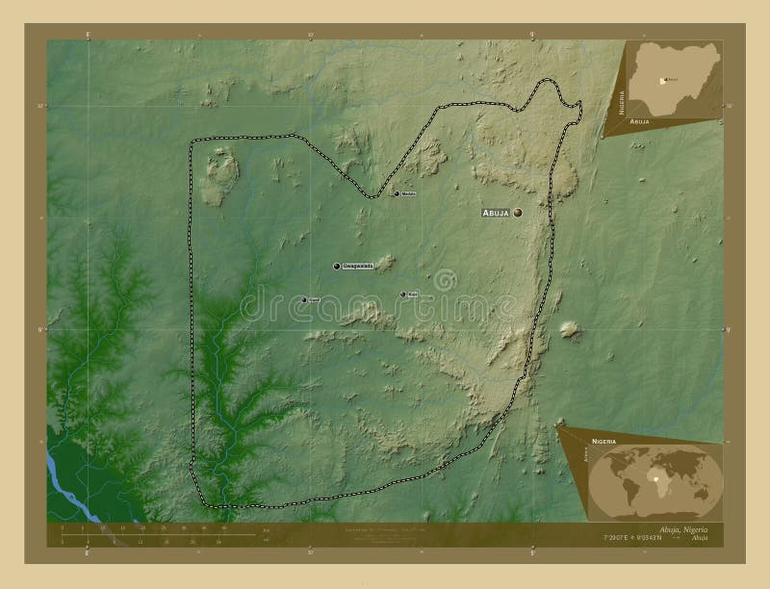
Geographic Hotspots & Untapped Potential
High-Performing Clusters
South-East (Ebonyi, Anambra)
Ilorin (South-West)
Delta (South-South)
Areas for Investigation
FCT shows lower than expected volume.
North-Central has moderate activity.
Data completeness to be verified.

Slide 13
04
Security & UX

Slide 14

Secure by Design: RLS Deployed
Row-Level Security (RLS) ensures each Regional Director sees only the data for their assigned zone, protecting sensitive information and ensuring compliance.
Role Definition
A security role filters the Directors table.
Dynamic Filter
The filter uses [Email] = USERPRINCIPALNAME() to dynamically show only the current user's data.

Slide 15
Intuitive Two-Click Experience
1. Executive Home Page
2. Regional Directors Page
KPIs, channel breakdown, product & promotion analysis, and time-based trends.
Zone filters, geospatial map, target gauge, and accountable MD profiles.
Bookmarks and a uniform corporate palette ensure a polished, intuitive, and professional user experience.

Slide 16
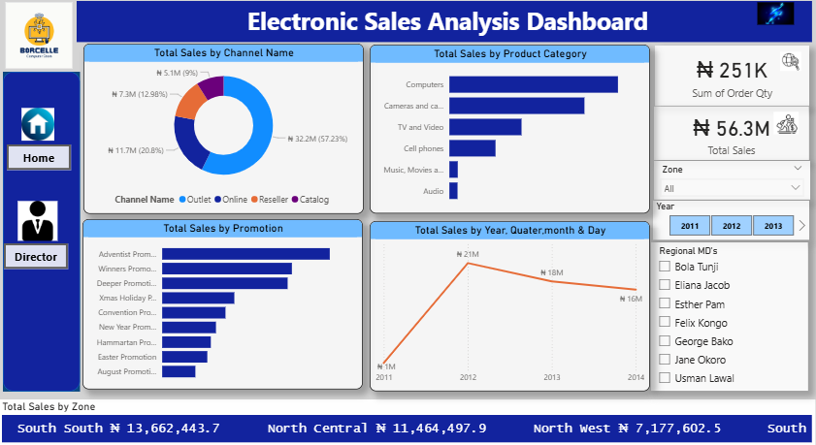

Slide 17
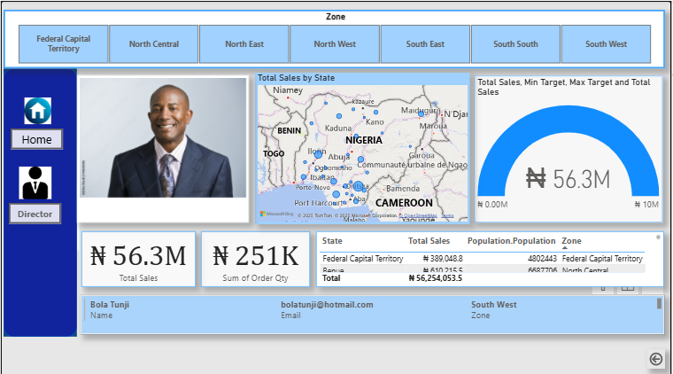

Slide 18
05
Decisions & Next Steps

Slide 19
Immediate Actions Approved
Prioritize Outlet Replenishment
Scale Successful Promotions
Focus on high-selling SKUs like Laptops and Projectors.
Replicate the mechanics of the top-performing Adventist Promo.
Invest in E-commerce
Investigate Data Gaps
Increase budget for online channel conversion optimization.
Look into the low sales volume reported in the FCT region.
Next Step:
Schedule daily data refresh and distribute role-restricted dashboards to all Regional Directors via Power BI Service.

Slide 20

Value Delivered & Future-Proofed
This dashboard is not just a report; it's a scalable decision-making platform that delivers immediate ROI and long-term strategic value.
Immediate Time Savings
Saves 4+ hours of executive time per review by replacing manual reports.
Live Performance Alerts
Provides live alerts when sales drift from targets, enabling proactive management.
Scalable Architecture
The star schema and documented DAX allow easy extension to new products, channels, or markets.

Slide 21




THANK YOU
Aduga
2025/08/05

